Slide 1
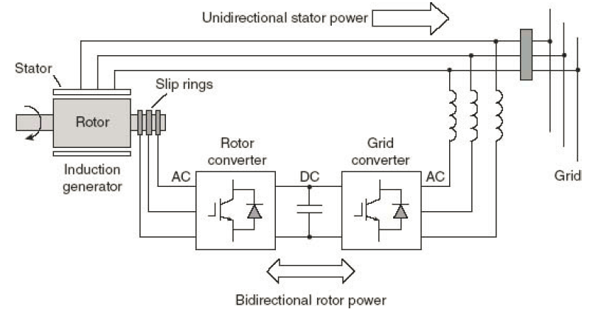
Doubly-Fed Induction Generator (DFIG)
Grid-synchronized ac currents
Figure 7.12
Grid-synchronized ac currents
Variable voltage and variable frequency ac currents
Key feature

